Slide 1
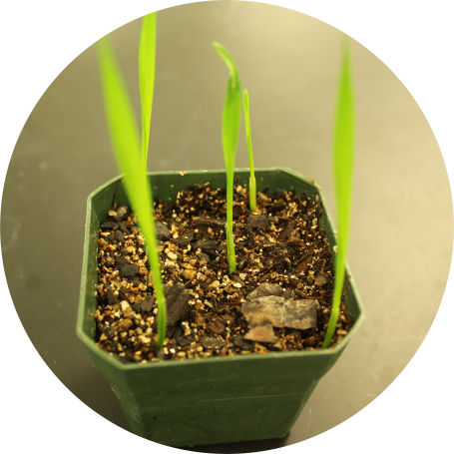
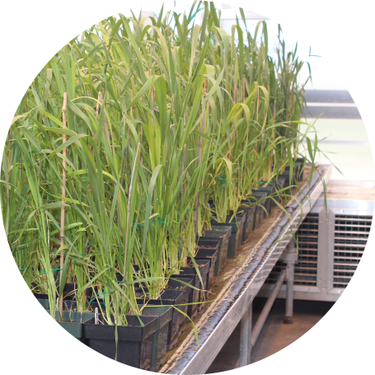
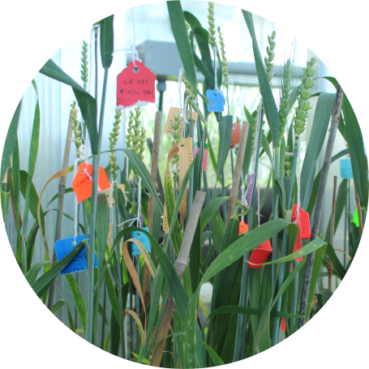
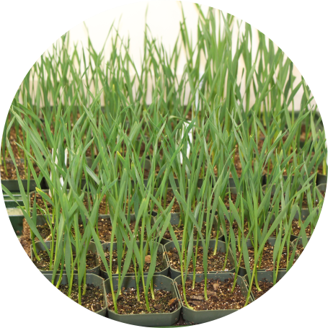
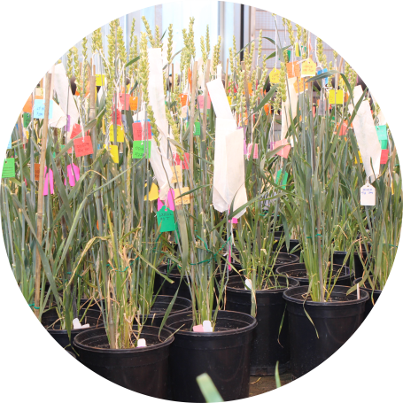
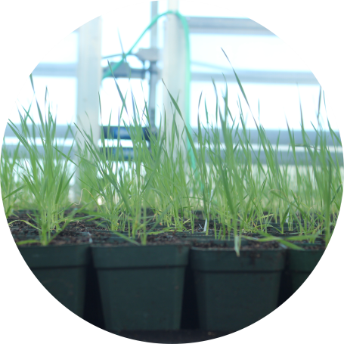
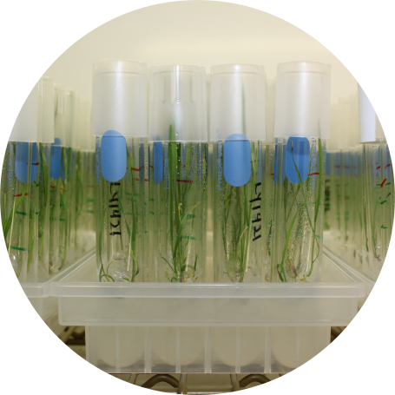
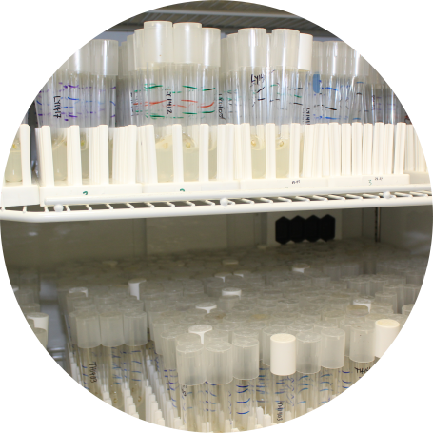
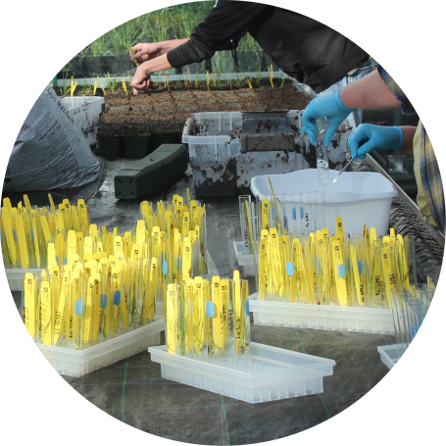
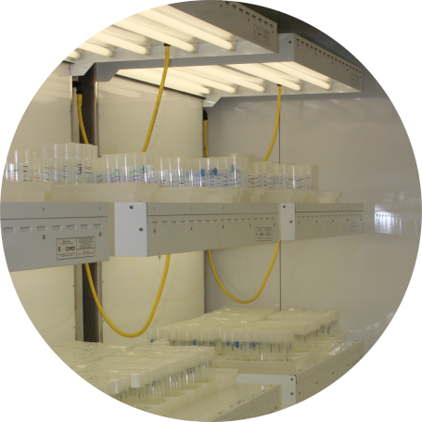
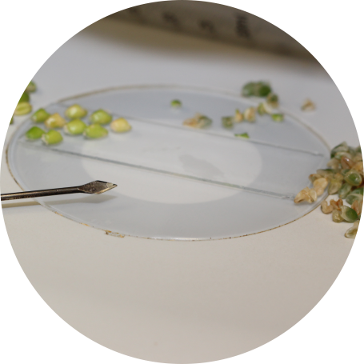
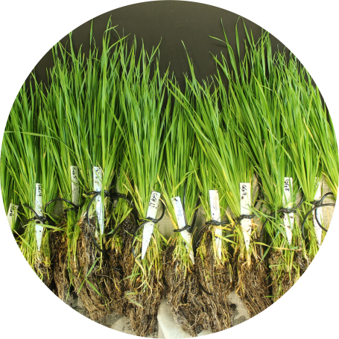
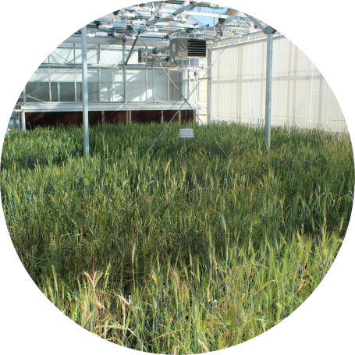
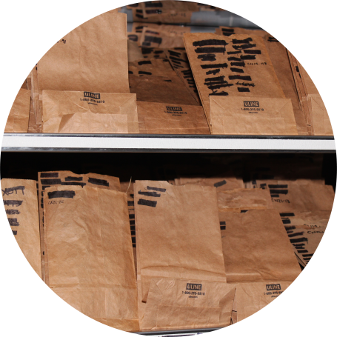
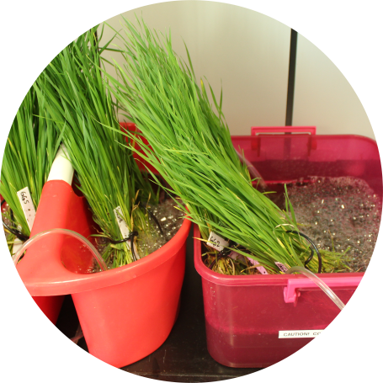
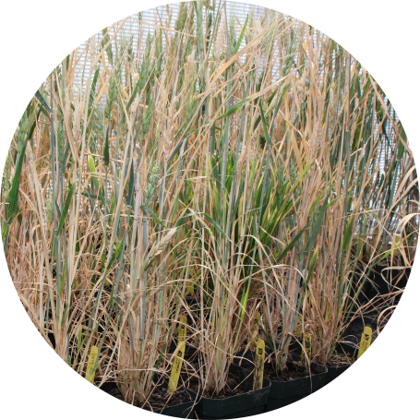
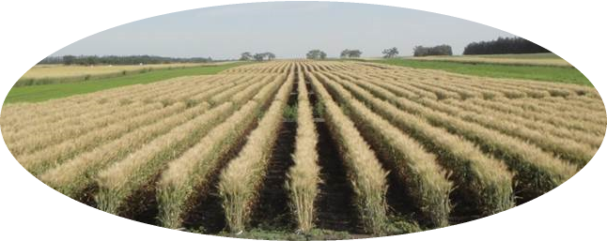
Doubled Haploid Process
Vernalization
8 weeks
Emasculation
10 weeks
Cold Treatment
1 week
Germination
2 weeks
Pre-emasculation Growth
7 weeks
Post-emasculation
3 weeks
Haploid Transplant
Light Chamber
2 weeks
Embryo Rescue
1 week
Haploid Growth
2 weeks
Haploid Vernalization
8 weeks
Dark Chamber
2 weeks
Colchicine Treatment and Recovery
1 week
Harvesting
1 week
Seed Packaging and
Shipping
Root Shake
Growth until Maturity
11 weeks
Drying and Threshing
1 week
Winter Wheat:
60 weeks = 14 months
Spring Wheat:
44 weeks = 11 months

